Slide 1
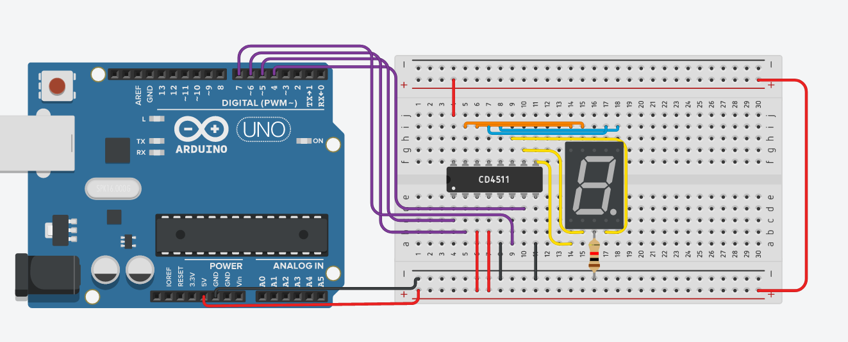
CS341 Lab 8:
7-segment displays
https://github.com/whittyh/CS341

Slide 2
Lab 7 Objectives:
Control a 7 segment display
Interface with CD4511BE cathode display controllers

Slide 3
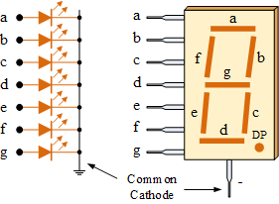
The 7 segment display:

Slide 4
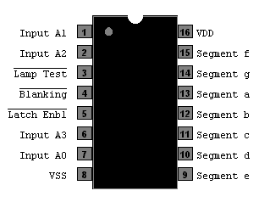
The CD4511BE
Controller that takes in 4-bit binary and outputs number
on display using 7 pins

Slide 5
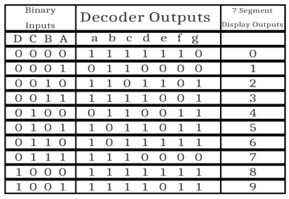
More on the Decoder:

Slide 6
Approach: (There are multiple ways to accomplish this)
Complete circuit and implement some logic in the loop to loop through digits 0-9 and convert each decimal value into 4 bits of binary and write to the display.
Example:
i = 3
4-bit binary representation of 3 = 0011
Would be:
digitalWrite(bits[3], LOW);
digitalWrite(bits[2], LOW);
digitalWrite(bits[1], HIGH);
digitalWrite(bits[0], HIGH);

Slide 7
Ideas:
Loop through 0-9 each main loop
For each value (0-9) identify which binary bits would be 1 or 0.
Can be done with:
Bitshifting
modulo and division
subtraction and if else statements
any other way you can come up with to take that value and isolate the value of each of the 4 bits, then write those bits.

Slide 8
Bitshifting:
Integer is 9: represented as:
0000 0000 0000 1001
(9 >> 3) returns:
0000 0000 0000 1
(9 >> 2) returns:
0000 0000 0000 10
(9 >> 1) returns:
0000 0000 0000 100
Extract right-most bit:
Modulo:
(int x)%2
OR
Binary Operator:
(int x) & 1

Slide 9
Overview:
4 pins from Arduino to decoder to write value
7 pins from decoder to display to convert binary value into 7 segment display decimal-representation
Write a loop that displays 0-9 and place in main loop
INCLUDE SMALL DELAY BETWEEN EACH VALUE

